Slide 1



Global Academy of Technology Rajarajeshwari Nagar,Bengaluru-560098
Department of Electronics and Communication Engineering
on
“SMART ENERGY METER”
PRESENTED BY:
Lakshmi Priya S [1GA22EC124]
Under The Guidance of:
Mrs. Bindu K
Assistant professor
Dept of ECE,GAT

Slide 2
CONTENTS
Introduction
Literature Survey
Problem Definition
Objectives
Method of Implementation
Outcome
Advantages and Disadvantages
Applications
References

Slide 3
INTRODUCTION
Electricity is essential for daily life and needs to be used wisely.
Some areas have surplus electricity, while others face deficits.
Current energy meters fail to accurately estimate power requirements.
Smart meters can monitor electrical parameters and energy consumption accurately.
Data is uploaded to a cloud platform, accessible to users for periodic monitoring.
The goal is to provide accurate power consumption data and improve energy management.

Slide 4
LITERATURE SURVEY
AUTHOR | TITLE | YEAR | DESCRIPTION
S. D. BhavaniPeri A.Ravi M. Supriya | Design and Implementation of a Real-time IoT Solution for Smart Meter Data Analysis in Microsoft Azure | 2024 | This research presents an IoT solution using Microsoft Azure to simulate smart meter data, focusing on real-time visualization and AI-based anomaly detection for spikes and dips.
Manoj M Doddamane Sai Sathwik P S Somashekhar Amoji | Design and implementation of IOT enabled Smart Energy Meter | 2023 | This paper proposes an IoT-enabled smart energy meter that offers more advantages than traditional meters. The meter tracks various parameters such as power, units consumed, current, voltage frequency, power factor, and fault status.

Slide 5
AUTHOR | TITLE | YEAR | DESCRIPTION
Dr Santosh Kumar K. Suneetha Amandeep Gill | Utilization of IoT and Smart Meters for Energy Management | 2023 | This research paper explores how an IoT-based Smart Energy Management System (SEMS), integrated with Entrack software, effectively improves energy management by utilizing smart meters for data collection and analysis.
Ishwarya Varadarajan Priyadharshini M Thanuja Babu P.Niveditha | IoT-Based Energy Meter Analysis Using Real-Time Data Monitoring | 2022 | This research highlights the importance of energy monitoring due to rising global energy use and the need for accurate billing based on meter readings.

Slide 6
PROBLEM STATEMENT
Traditional electric meters face challenges like inaccurate billing, lack of real-time data, and limited consumer awareness, leading to inefficiencies, higher operational costs, and energy waste. Develop a Smart Electric Meter that provides real-time, accurate consumption data, improving billing accuracy, enabling energy optimization, and reducing waste for both consumers and utilities.

Slide 7
OBJECTIVES
Provide real-time data on energy usage.
Quick response to outages.

Slide 8
METHOD OF IMPLEMENTATION
The PZEM-004T sensor measures voltage, current, power, and energy consumption, transmitting the data to the NodeMCU ESP8266 via UART.
The NodeMCU processes and converts the raw data into readable values like watts, volts, and kWh
The NodeMCU sends the processed data to the Blynk Cloud server through a Wi-Fi connection.
Real-time energy parameters (voltage, current, power, energy) are shown on the Blynk app, allowing users to track and analyze their energy usage.

Slide 9
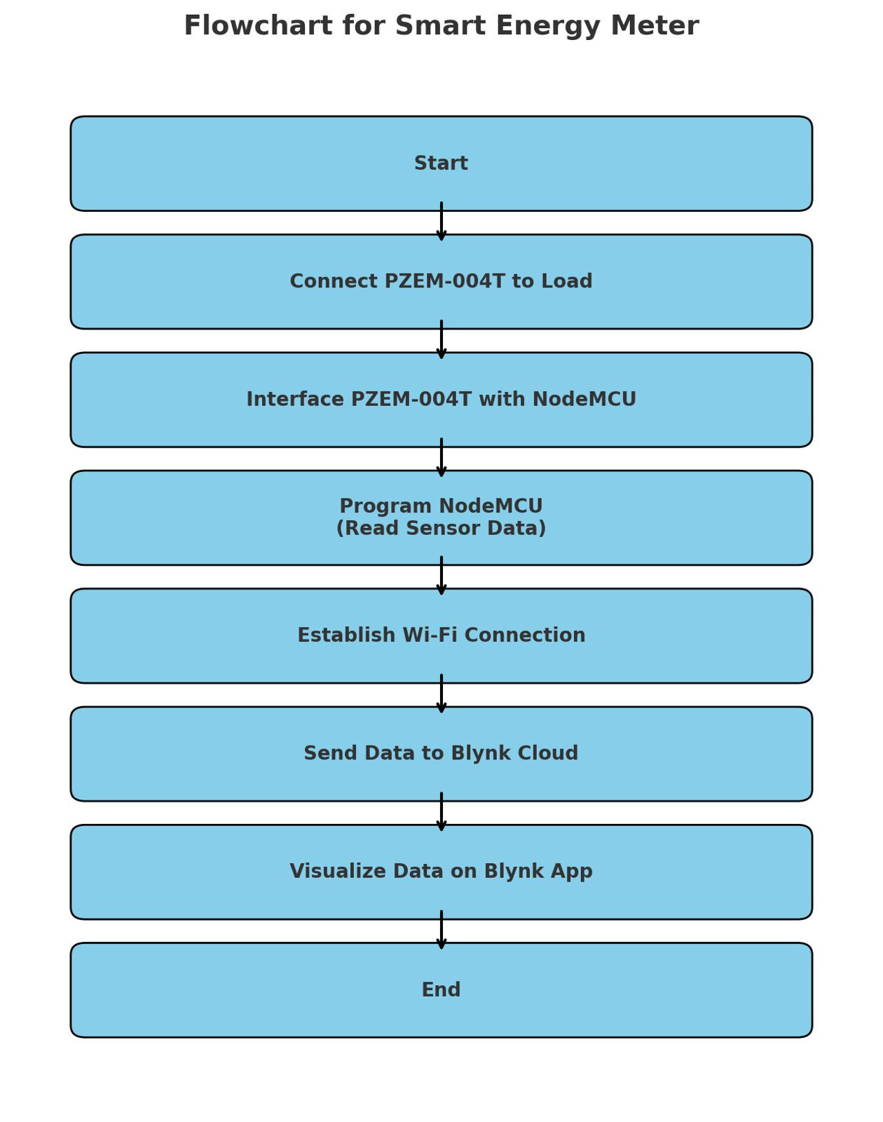
Flow chart for smart meter
Figure 1
Flow chart for smart meter

Slide 10
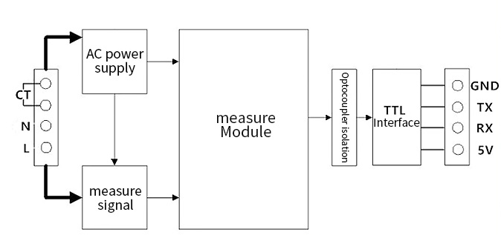
Block Diagram of smart meter
Figure 2
Block Diagram of smart meter

Slide 11
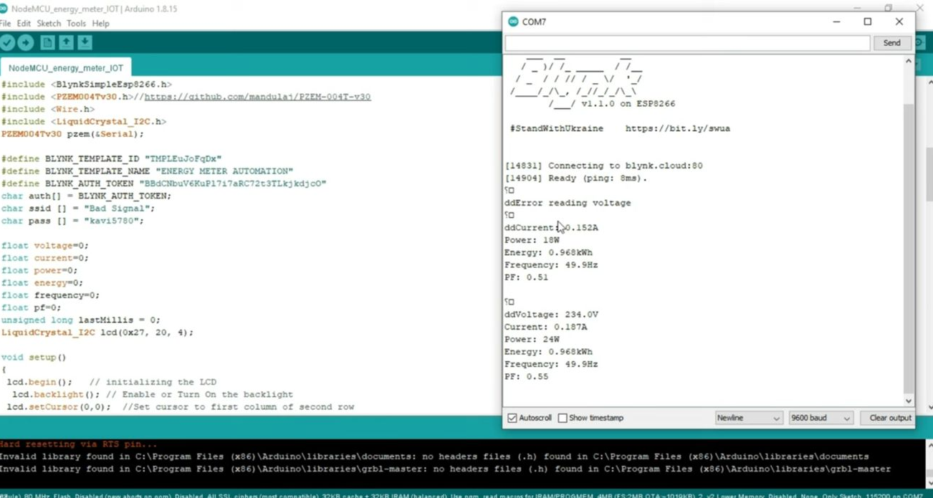
OUTCOME
Figure 3
Screen shot of data obtained

Slide 12
Advantages
Real-Time Monitoring.
Remote Access.
Supports Renewable Energy.
Environmental Benefits.

Slide 13
Disadvantages
Privacy Concerns.
Dependence on Internet.
Power Dependency.

Slide 14
APPLICATIONS
•Residential energy monitoring.
•Industrial energy management.
•Smart grid systems.
•Renewable energy integration.
•Real-time energy billing .

Slide 15
References
[1] S. D. BhavaniPeri, A. Ravi and M. Supriya, "Design and Implementation of a Real-time IoT Solution for Smart Meter Data Analysis in Microsoft Azure," 2024 15th International Conference on Computing Communication and Networking Technologies (ICCCNT), Kamand, India, 2024
[2]M. M. Doddamane, S. S. P. S, S. Amoji, V. M. G and G. H. Reddy, "Design and Implementation of IOT Enabled Smart Energy Meter," 2023 7th International Conference on Design Innovation for 3 Cs Compute Communicate Control (ICDI3C), Karnataka, India, 2023.
[3]S. Kumar, K. Suneetha and A. Gill, "Utilization of loT and Smart Meters for Energy Management," 2023 International Conference on Power Energy, Environment & Intelligent Control (PEEIC), Greater Noida, India, 2023
[4] Varadarajan, T. Babu, P. M and P. Nivedhitha, "IoT-Based Energy Meter Analysis Using Real-Time Data Monitoring," 2022 1st International Conference on Computational Science and Technology (ICCST), CHENNAI, India, 2022.
[5] G. Mehta, R. Khanam and V. K. Yadav, "A Novel IoT based Smart Energy Meter for Residential Energy Management in Smart Grid Infrastructure," 2021 8th International Conference on Signal Processing and Integrated Networks (SPIN), Noida, India, 2021.

Slide 16
[6] R. Mishra, A. Pandey and J. Savariya, "Application of Internet of Things: Last meter smart grid and smart energy efficient system," 2020 First International Conference on Power, Control and Computing Technologies (ICPC2T), Raipur, India, 2020.
[7]M. M. Haque, Z. H. Choudhury and F. M. Alamgir, "IoT Based Smart Energy Metering System for Power Consumers," 2019 2nd International Conference on Innovation in Engineering and Technology (ICIET), Dhaka, Bangladesh, 2019.
[8] S. Saha, S. Mondal, A. Saha and P. Purkait, "Design and Implementation of IoT Based Smart Energy Meter," 2018 IEEE Applied Signal Processing Conference (ASPCON), Kolkata, India, 2018.
[9] D. B. Avancini, S. G. B. Martins, R. A. L. Rabelo, P. Solic and J. J. P. C. Rodrigues, "A Flexible IoT Energy Monitoring Solution," 2018 3rd International Conference on Smart and Sustainable Technologies (SpliTech), Split, Croatia, 2018.
[10] M. Aboelmaged, Y. Abdelghani and M. A. Abd El Ghany, "Wireless IoT based metering system for energy efficient smart cites," 2017 29th International Conference on Microelectronics (ICM), Beirut, Lebanon, 2017.

Slide 17
THANK YOU

